Slide 1



World Happiness Data from Kaggle
Rafael Djamous
Tulane University
CMPS-3160: Data Science
Proffesor: Aron Culotta
December 7th , 2022

Slide 2
Introduction
The report reviews the state of happiness in the world today and show how the new science of happiness explains personal and national variations in happiness (Alba, n.d.).
Past trends have shown that if you have money, then you are happier , yet research tends to debate this.
Happiness and income create an endogeneity problem since they interact with one another.
I hope to find out whether or not excess happiness in a country has a dampening effect on GDP.

Slide 3
Data Sources and Loading of Data
Extraction of data from Kaggle is quite different when compared to other sources.
We make use of the open datasets library to download the dataset from Kaggle.
This prompts us to provide the details like the Kaggle username and the key, we are obtained in a json file downloaded from Kaggle under the ‘Account’ option
After providing these details, the dataset is downloaded and extracted to our working directory.
From here, we can then read the csv file using the read_csv method of Pandas

Slide 4
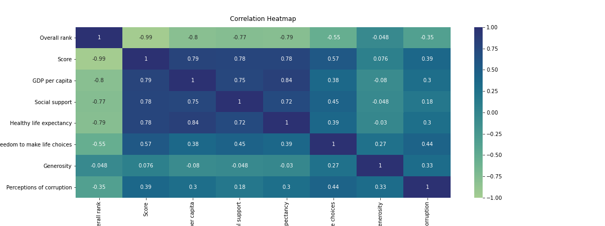
Exploratory Data Analysis
In the EDA, we checked for the data types in the data, the correlation between them and also the measures of central tendency for the numerical variables.
All are numerical variables except 'Country or region'. The data is also distributed over 156 different countries.
We can see that there is a high correlation between 'Score' and GDP per capita, Social support, Healthy life expectancy & Freedom to make life choices
Notes:
-high correlattion between Score and GDP per capita

Slide 5
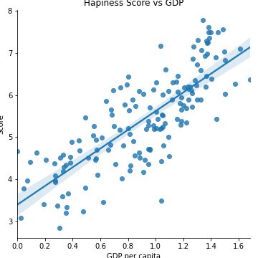
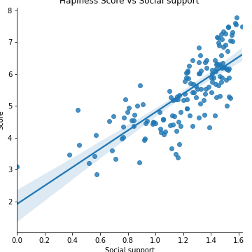
Analysis
The main goal was to uncover a correlation between the happiness score and the GDP per capita . Seaborn was used to create a scatterplot with a regression line.
In nations with great personal freedom, happiness was likewise high. Social support, healthy life expectancy, and freedom to make life choices correlate highly with happiness.
High-correlation variables may be used to predict 'Score' using machine learning models like MLR.

Slide 6
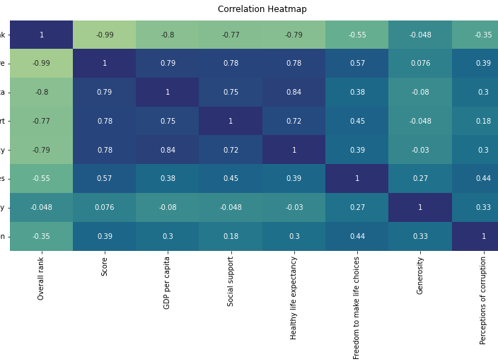
Scanning
Score correlates highly with GDP per capita, social support, healthy life expectancy, and freedom to make life choices.
Since happiness is directly proportional to GDP, we may obtain a dataset using GDP as the goal variable and observe its proportional components.

Slide 7
Hypothesis
There is a positive correlation between happiness and GDP
Our results based on Hypothesis Testing determines the happiness of the Global North is greater than that of the Global South.
Furthermore, our queries show that the mean happiness score for the Global North significantly outweighing that of the South.
Likewise, the 10 'Happiest' nations all belong to the Global North whereas the 10 'least happy' nations belong to the Global South.
Top 3 Happiest Country: Finland, Denmark, Iceland

Slide 8
Conclusion
From the project, we were able to import different sets of data and as well extract meaningful insights from them.
We learned how to use pandas to import data from a website, identify data categories, and calculate central tendency.
In addition, we knew how to determine the connection between data variables.
Happiness score correlated with GDP per capita, social support, healthy life expectancy, and freedom to make life choices.

Slide 9



THANKS FOR LISTENING!

